Slide 1

Container Orchestration
Definition
Features
Container orchestration refers to the automated management, deployment, scaling, and networking of containerized applications. It enables the coordination of multiple containers, often across multiple hosts, ensuring that the applications run efficiently and reliably.
Automated Deployment: Automatically deploys containers based on defined configurations and specifications.
Scaling: Dynamically scales applications up or down based on demand and resource availability.
Load Balancing: Distributes traffic evenly across containers to optimize resource use and prevent overload.
Service Discovery: Automatically discovers and communicates with services within the container ecosystem.
Health Monitoring: Continuously monitors the health of containers and replaces unhealthy instances.

Slide 2
Container Orchestration
Advantages
Disadvantages
Efficiency: Streamlines the management of containerized applications, reducing operational overhead.
High Availability: Ensures that applications remain available and can recover from failures automatically.
Resource Optimization: Maximizes the utilization of underlying infrastructure resources.
Consistent Deployment: Provides consistent deployment and scaling strategies, reducing the risk of errors.
Complexity: Adds complexity to the architecture, requiring additional tools and knowledge.
Learning Curve: Can have a steep learning curve for teams unfamiliar with orchestration technologies.
Overhead: Introduces additional overhead in terms of resources consumed by the orchestration platform itself.
Network Dependencies: Requires reliable networking, as containers often depend on network communication.

Slide 3
Container Orchestration
Working
Container orchestration works by using a centralized control plane to manage the lifecycle of containers across multiple hosts. The orchestrator automates the deployment of containerized applications by:
Defining Deployment Configurations: Users define configurations for services, including the number of replicas, resource limits, and networking settings.
Scheduling Containers: The orchestrator schedules containers to run on available nodes based on resource requirements and policies.
Monitoring and Management: The orchestrator continuously monitors the state of the containers and takes corrective actions if needed, such as restarting failed containers or scaling up/down based on load.

Slide 4
Container Orchestration
Types
Managed Container Orchestration: These are cloud-based orchestration services offered by cloud providers that handle the management and scaling of containers automatically. Examples: Amazon ECS (Elastic Container Service, Google Kubernetes Engine (GKE), Azure Kubernetes Service (AKS).
Self-Managed Container Orchestration: These are orchestration platforms that users deploy and manage on their own infrastructure, providing greater control and flexibility. Examples: Kubernetes, Docker Swarm
Hybrid Container Orchestration: This type combines both on-premises and cloud-based orchestration solutions, allowing for flexible deployment strategies. Examples: OpenShift
Serverless Container Orchestration: This model abstracts the server management aspect completely, allowing users to focus solely on writing and deploying their applications. Examples: AWS Fargate
Service Mesh: A dedicated infrastructure layer that manages service-to-service communication within containerized applications, typically used alongside orchestration. Examples: Istio
Multi-Cluster Orchestration: This type manages multiple clusters across different environments (cloud and on-premises) to provide high availability and disaster recovery. Examples: Red Hat Advanced Cluster Management for Kubernetes
Edge Orchestration: Focused on managing containers at the edge of the network, close to the data source or end-users, optimizing latency and bandwidth. Examples: K3s

Slide 5
Container Orchestration
Lifecycle
Components
Design: Define application architecture and requirements.
Deployment: Deploy containers based on defined configurations.
Scaling: Adjust the number of running containers based on demand.
Management: Monitor and manage container health and performance.
Termination: Safely terminate containers when no longer needed.
Orchestrator: The central control plane that manages containers.
Nodes: Individual servers or virtual machines where containers run.
Services: Defined applications consisting of one or more containers.
Load Balancers: Distribute traffic across container instances.
Networking: Connects containers and services within the orchestration environment.

Slide 6
Container Orchestration
Popular Tools of Container Orchestration
Kubernetes: Kubernetes is a powerful open-source container orchestration platform that automates the deployment, scaling, and management of containerized applications across clusters of hosts.
Docker Swarm: Docker Swarm is Docker's native clustering and orchestration tool that enables the easy management of a cluster of Docker nodes as a single virtual system.
Apache Mesos: Apache Mesos is a cluster manager that abstracts resources across a large number of machines and is designed to run applications in a fault-tolerant and elastic manner.
Amazon ECS (Elastic Container Service): Amazon ECS is a fully managed container orchestration service provided by AWS that enables users to easily run, scale, and secure Docker containers on the cloud.
HashiCorp Nomad: HashiCorp Nomad is a flexible and easy-to-use workload orchestrator that enables users to deploy and manage containers and non-containerized applications across various infrastructures.

Slide 7
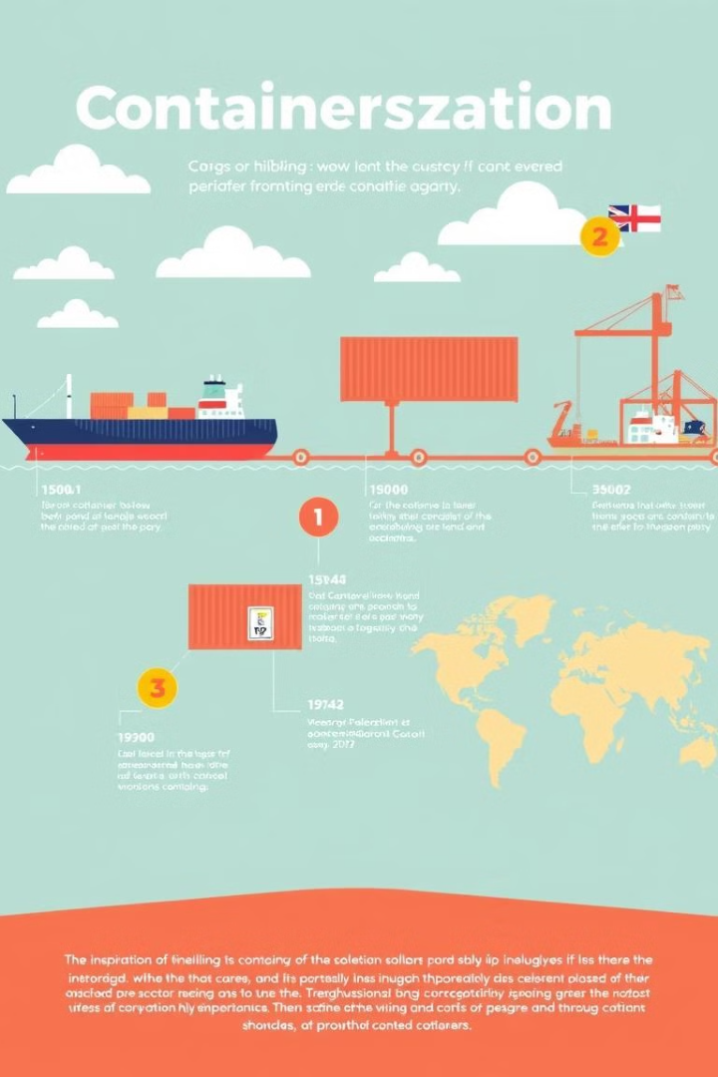
Why Container Orchestration?
Container orchestration is essential for managing complex, distributed applications effectively. It helps organizations automate deployment, scaling, and management of containerized applications, leading to improved efficiency, reliability, and resource utilization.

Slide 8
History of Container Orchestration
1
Early Container Technologies
Early containerization efforts emerged in the late 1990s and early 2000s, focusing on virtual machine-based isolation.
2
Docker's Impact
Docker revolutionized containerization in 2013 by introducing a lightweight and portable container format, simplifying deployment and portability.
3
Container Orchestration Platforms
The need for automated container management and scaling led to the development of orchestration platforms like Kubernetes.

Slide 9

Challenges and Considerations in Container Orchestration
1
Complexity
2
Security
Kubernetes is powerful but can be complex to set up and manage, requiring technical expertise.
Securing containers, networks, and the entire cluster is critical and requires careful consideration.
3
Resource Management
Balancing workloads, optimizing resource utilization, and ensuring efficient resource allocation is crucial.

Slide 10



Real-World Use Cases and Best Practices
Web Applications
Microservices
Data Processing
Deploying and scaling web applications using Kubernetes enables high availability, automated updates, and efficient resource utilization.
Container orchestration facilitates the deployment and management of microservices, enhancing modularity, scalability, and resilience.
Kubernetes can be used to orchestrate data processing pipelines, enabling efficient scaling, resource management, and fault tolerance.

Slide 11
Best Practices for Effective Container Orchestration
Design for Resilience: Build applications that can handle failures gracefully and recover automatically.
Monitor and Log: Implement robust monitoring and logging to track application performance and troubleshoot issues.
Utilize Declarative Configurations: Use declarative configurations to define desired states, ensuring consistency and ease of management.
Optimize Resource Usage: Regularly review resource allocation and adjust configurations to optimize performance and cost.
Regularly Update: Keep the orchestration platform and container images up to date with the latest security patches and features.

Slide 12
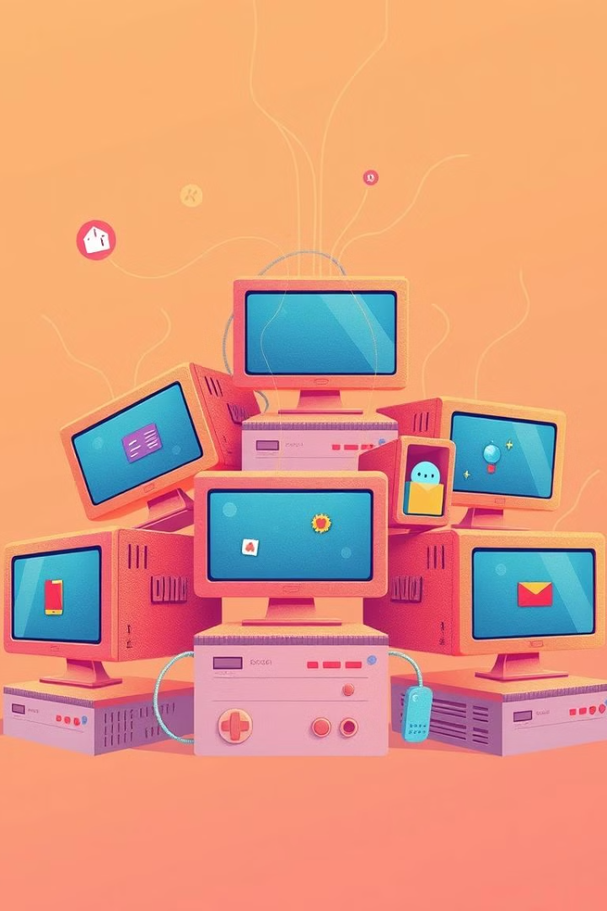
Integrating with CI/CD Pipeline
Container orchestration integrates with CI/CD pipelines by automating the deployment of containerized applications. The integration typically involves:
Continuous Integration: Automated testing and building of container images in the CI stage.
Continuous Deployment: The orchestrator automatically deploys the built images to the production environment after passing tests.
Rollback Mechanism: In case of failure, the orchestration platform can quickly roll back to a previous stable version.
Monitoring: Continuous monitoring ensures that applications are running correctly, allowing for quick responses to issues.

Slide 13
Declarative vs. Imperative
Feature | Declarative | Imperative
Definition | Specifies what the desired state is | Specifies how to reach the desired state
Approach | Defines the final state and system figures out how to achieve it | Step-by-step instructions to achieve the goal
Example | Kubernetes manifests, Terraform | Command-line operations, shell scripts
Flexibility | More scalable, self-healing | More control, manual intervention
Use Case | Infrastructure-as-Code (IaC), automation | Manual operations, one-off tasks

Slide 14
Single-Cluster vs. Multi-Cluster
Feature | Single-Cluster | Multi-Cluster
Definition | Operates within a single Kubernetes cluster | Operates across multiple clusters
Scalability | Limited scalability, bound by single cluster | Highly scalable across clusters
Fault Tolerance | Single point of failure | Fault-tolerant with multiple clusters
Use Case | Small to medium-sized deployments | Large-scale, geo-distributed deployments
Management Complexity | Easier to manage, centralized control | More complex management and coordination

Slide 15
Kubernetes vs Docker Swarm
Feature | Kubernetes | Docker Swarm
Primary Use Case | Advanced container orchestration | Simple container orchestration
Setup Complexity | Complex, steep learning curve | Simple, easy to set up
Scalability | Highly scalable and flexible | Moderate scalability
Networking | More advanced, customizable | Simpler networking model
Fault Tolerance | Built-in self-healing and high availability | Basic high availability
Use Case | Large, production environments | Smaller, simpler environments

Slide 16
Kubernetes vs Docker Swarm vs Apache Mesos
Feature | Kubernetes | Docker Swarm | Apache Mesos
Primary Use Case | Container orchestration | Lightweight container orchestration | General resource management, supports containers and other workloads
Setup Complexity | Complex, requires in-depth setup | Simple, fast to set up | Complex, flexible but challenging to configure
Scalability | Highly scalable | Moderately scalable | Extremely scalable for large data centers
Networking | Advanced networking | Simplified networking | Customizable but complex networking
Fault Tolerance | Built-in fault tolerance, auto-healing | Basic high availability | Highly fault-tolerant, distributed architecture
Use Case | Large-scale container deployments | Small to medium-sized containerized apps | Large-scale resource and workload management across diverse environments

